Slide 1
MARKOV ANALYSIS ALGORITHM
GROUP N0 :06
GROUP MEMBERS :
ROLL NO :
66 - Vaishnavi Nagwekar
47- Rounak Katiyar
28- Janhavi Gangawane
24- Aditya Dikonda

Slide 2
Problem Statement
Develop a Java Program for the following problem description the project work shall consist of coding for the functional requirement of the problem description and shall demonstrate various Object-oriented programming constructs and methodologies for example constructors, copy constructors ,destructors , inheritance, polymorphism, object as function parameters, exception handling ,container classes and GUI with swing components

Slide 3
MARKOV ANALYSIS AND IT’S USES
Markov analysis is a method used to forecast the value of a variable whose predicted value is influenced only by its current state, and not by any prior activity
Markov analysis is often used for predicting behaviors and decisions within large groups of people
Here are some common uses and examples of Markov analysis:
Finance and Economics:
Stock Price Modelling , Economic Forecasting
Biology and Genetics:
Bioinformatics , Epidemiology
Environmental Science:
Climate Modeling:

Slide 4
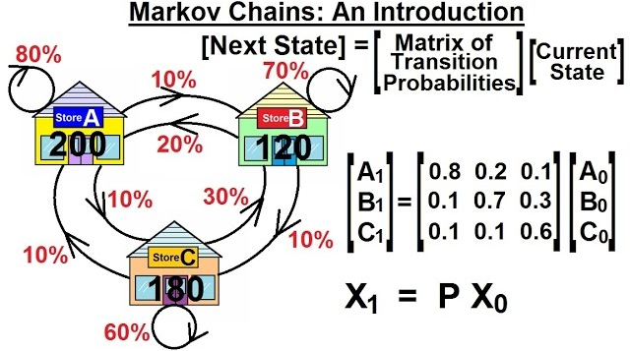



EXAMPLE OF MARKOV ANALYSIS

